Slide 1

PROJECT
SINO EUROPA
PROJECT TEAM PRESENT

Slide 2


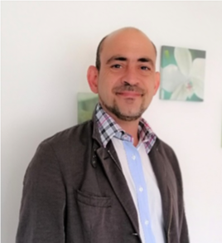
Our Team
Jack Lin
Brigitte Tong
Dimitris Vogiatzopoulos
Founder and MD
of Top Group International BV since 2001
CEO of Sino Europa Project Team
Director of Top Group International BV
CFO of Sino Europa Project Team
Global Procurement Consultant
of Sino Europa Project Team

Slide 3







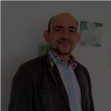
Our Team
King’s College and SouthBank University Undergrad
in Mechanical Engineering B Eng.
Business Consultant for Port of Rotterdam since 2011
Global Marketing Consultant – Aleph(艾礼富电子有限公司)
Global Strategic Consultant – TGI Live since 2016
Jack Lin
Founder and MD
of Top Group International BV since 2001
CEO of Sino Europa Project Team
Guest Lecturer for Master in Supply Chain Management of Business School for University of Bedfordshire
External Examiner for Master in Supply Chain Management and Master in Mechanical Engineering of Business School for University of Bedfordshire
21
Brigitte Tong
Dimitris Vogiatzopoulos
years of experience in the Logistics / Supply-Chain industry
Director of Top Group International BV
CFO of Sino Europa Project Team
Global Procurement Consultant
of Sino Europa Project Team

Slide 4



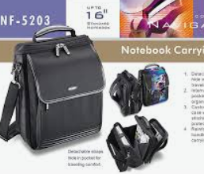








20
International Marketing –
Owner of Sytari from 1992 – 2002 specialist in POS monitor
Owner of Azona Brand worldwide since 1997 ~2012 in computer Accessories & Bags
Shareholders of Rockfire European office from 1994-1997
Our Team
Years
diversified
working
experience
Setup new OEM branding in various countries,
such as UK Top 10 Football club, Manchester United, Chelsea, Liverpool, etc, Swiss Army, Media Market , Vobis, ECS Elite Group, Proview, Japan Sanwa, Fellows, USA, RadioShack, Teac, Verbatim, Australian Dick Smith & Woolworth , Venezuela Saigon, Logitech, Axis in S.Africa Sega/Nintendo gaming, etc many renowned brand worldwide
Products Development – Develop new products with customized packaging to meet market requirements.
Brigitte Tong
Procurement - 1988 ~1990 at Vendex International
Management - 1990 – 1992 Tainic International
Director of Top Group International BV
CFO of Sino Europa Project Team
Customer relation – Always maintain good relationship with customer for mutual benefit.
Dimitris Vogiatzopoulos
Jack Lin
International Exhibitions – Fully experienced in international exhibitions worldwide.
Global Procurement Consultant
of Sino Europa Project Team
Founder and MD
of Top Group International BV since 2001
CEO of Sino Europa Project Team

Slide 5








18
“Economic Science”
University of Macedonia Thessaloniki Greece
Development of Strong Analytical skills with different Financial and Statistical Performance Indicators. Focus on detail with highly developed numerical capabilities.
Microsoft Course 2018 : EXCEL for ANALYSTS
Our Team
Years
experience in
Procurement
positions
with European
and Asian
suppliers.
Military Officer Rank ‘Lieutenant’
Solid People Management experience during Military Service in Artillery , Greek Army
Ranked 8th (out 90 ) in Artillery School Athens
Service in Greek – Turkish Borders and in the III Army Corps / NATO Rapid Deployable Corps – Thessaloniki Greece
Dromeas S.A. Greece 2002, 2004
Purchasing Activities National Level
Planning-Supervising of installation of 20.000 furniture Units
for Olympic Games in Athens 2004 with high safety and security standards (14fte’s)
Field S.A. Greece 2005
Purchasing Europe and Asia
20% Cost reduction in raw materials
( Imports China – Taiwan – India – Germany – Italy – Turkey )
New Product Launch FIELD FITNESS ( Home fitness equipment ) ( CIF calculations ,retail positioning )
Dimitris Vogiatzopoulos
Business Development – Purchasing
CEO negotiations, representation contracting, supplier development : Turkey/ Italy/ Bulgaria/ The Netherlands ( Bathroom products ) , DIY Praktiker , Leroy Merlin
Global Procurement Consultant
of Sino Europa Project Team
Mind products 2007
Business Development in Gemma Solid Works 2014
400% Turnover Increase ( 2014 300.000 € – 2017 1.200.000 € )
Implementation of production and quality efficiencies ( 2014 6 fte’s - 2017 16 fte’s )
Development of Online Marketing tools ( Online Catalogue, Order forms, EuroPages Presentation, WLW.de presentation )
Jack Lin
Brigitte Tong
Project Management Hotels
Founder and MD
of Top Group International BV since 2001
CEO of Sino Europa Project Team
Director of Top Group International BV
CFO of Sino Europa Project Team
( Van der Valk Tilburg / Apeldoorn Van der Valk Group, MOXY Hotels Europe Marriot Group, Jakarta Hotel Amsterdam Westcord Group ) Production Planning – Quality Control – Delivery Planning – Installation Planning and control

Slide 6


Our Vision,
Our Goal
We have a dream,
“ to build the biggest Asian logistics & exhibition center in Europe
where the East meets the West, bilateral trade interactive,
create mutual economic benefits, to achieve a win-win situation .”

Slide 7

Sino Europa
Our Vision,
Our Goal
We have a dream,
“ to build the biggest Asian logistics & exhibition center in Europe
where the East meet the West, bilateral trade interactive,
create mutual economic benefits, to achieve a win-win situation .”

Slide 8


Our Vision,
Our Goal
To achieve this goal, we first follow the One Belt One Road initiative spirit , offering both Asian & European entrepreneurs business opportunities.
We have a dream,
“ to build the biggest Asian logistics & exhibition center in Europe
where the East meet the West, bilateral trade interactive,
create mutual economic benefits, to achieve a win-win situation .”

Slide 9

Our Vision,
Our Goals
We design a substantial platform to enhance bilateral business connectivity between Chinese or Asian enterprises and the potential counterparts in Europe and to come to an elevated successful business situation.
We have a dream,
“ to build the biggest Asian logistics & exhibition center in Europe
where the East meet the West, bilateral trade interactive,
create mutual economic benefits, to achieve a win-win situation .”

Slide 10





Sino-Europa,
Logistic City in Europe!
Create the biggest platform in Europe to promote & introduce:
European products emphasizing in
Product Quality & Uniqueness
Chinese products focusing on Product Diversity & Price

Slide 11



Sino-Europa,
Logistic City in Europe!
Develop the biggest Asian Logistic Distribution Centre in Europe:
Linking Europe and China / Asia
Logistics City with Exhibition Arena within its compound
Exhibition Arena to showcase the Chinese products to the European buyers
Exhibition Arena to showcase the European products to the Chinese promoters
Provide a ground for Entrepreneur to establish & develop

Slide 12


Sino-Europa,
Logistic City in Europe!
1
Promote and carry through the essence of One Belt One Road:
A Platform to create marriages of Chinese and European between products and promoters!
Moving European products to China;
Moving Chinese products to Europe.
2
Promote and Solidify Chinese Business Position in Europe:
Increase Chinese influence in Europe.
3
Promote Healthy E-commerce Concept
Understand European Tax & Customs rules and laws;
Help Chinese E-Commerce seller to import to Europe.
Balance the Sino-European positions!

Slide 13





Who is
Top Group International (TGI) B.V.?
Top Group International BV founded in 2001, is the first self-run Chinese / Taiwanese Forwarding & Logistic Company in the Netherland. We are specialized in…
Legal, Tax & Financial Consultant Team, assisting customer with GFR & BV setup plus Admin & Finance administration control.
Own Operating Team for Logistic & Forwarding +
VAS (Value Added Service) with rework facilities.
Licensed & Certified in Bonded Customs, Venue Customs for E-commerce supported by in-house & external Customs Team.
IND (Immigration & Naturalisation Service) government approved partner in assisting work & resident permit application.
We are your Total Supply-Chain solution Partner!

Slide 14

2018: Broadening
Global Growth
6%
Global rent growth
5%
European rent growth
5%
European rent growth
2019
What’s next ?
2-3%
HIGHEST MARKET RENTAL
GROWTH, EUROPE
Rotterdam
Budapest
Prague
Greater Silesia
Hannover
Acceleration in Europe. Rental growth escalated to 5%, a break from the recent 2-3% that had characterized the last several years, as growth broadened on the continent, led by a roll down in concessions and increases in headline rates.
Uncertainty and volatility from the macroeconomic environment. Though far from broad-based, some economic indicators have softened and warrant caution. Uncertainty (e.g., Brexit and U.S.-China frictions) reduces expectations, which could reduce growth.

Slide 15

2018: Broadening
Global Growth
What does it means?
For investors
For customers
Location is a more important factor than ever in investment decisions.
Markets with high barriers to supply and those serving urban cores will find a steady flow of requirements from both business expansion plans and reassessment of supply chain strategies. Such markets should enjoy long-term forecasts of low vacancies and rent growth.
We expect that rents will continue to rise in 2019—even if at a slower pace.

Slide 16

2018: Broadening
Global Growth
Europe
Rent growth accelerated in 2018.
Net effective rents rose 5% for Europe as a whole, the highest in data dating back more than 10 years.
Several drivers coalesced.
1
First is strong market fundamentals, with positive customer sentiment, robust demand, disciplined supply, land scarcity and historic low vacancy of 3.2%.
2
Second, rents are still at a discount compared to prior benchmarks and replacement-cost rents in most markets.
3
Third, replacement costs are rising, driven by increasing construction costs and land prices, which is affecting development underwriting and pushing rent growth in most markets.

Slide 17

2018: Broadening
Global Growth
First is strong market fundamentals, with positive customer sentiment, robust demand, disciplined supply, land scarcity and historic low vacancy of 3.2%.
Second, rents are still at a discount compared to prior benchmarks and replacement-cost rents in most markets.
Third, replacement costs are rising, driven by increasing construction costs and land prices, which is affecting development underwriting and pushing rent growth in most markets.
The European continent played an outsized role with 6% growth.
Recent years enjoyed only pockets of growth, robust rent growth arose in mature markets such as Munich, Southern Netherlands, Gothenburg and Prague. Rent growth in these markets was driven by strong market base

Slide 18
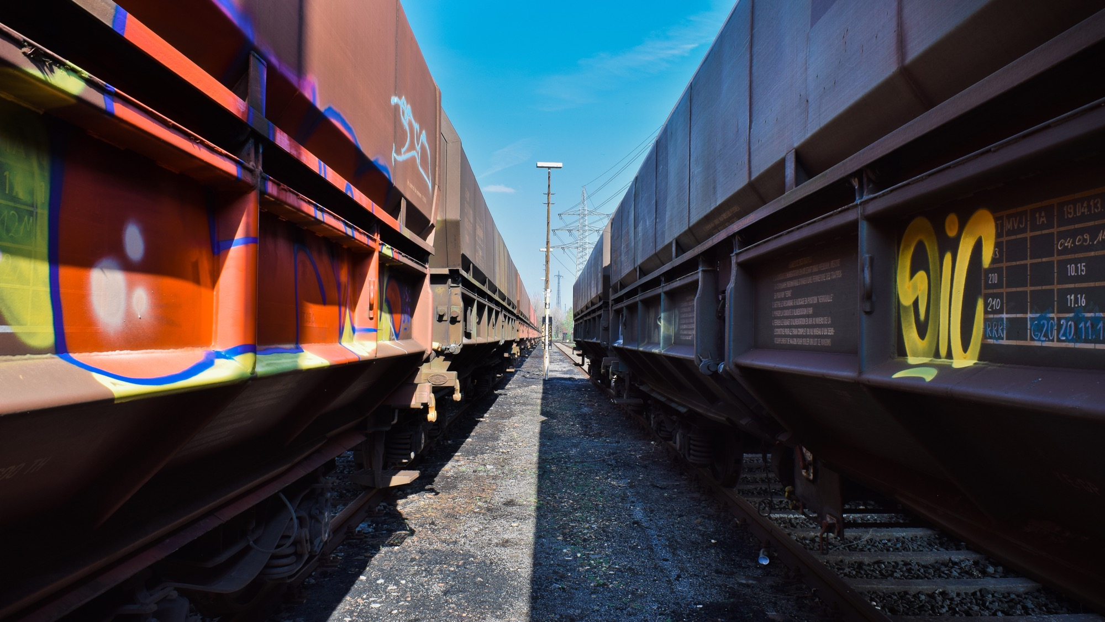




2018: Broadening
Global Growth
2019 outlook
Rents are expected to rise throughout 2019, despite some rising pace uncertainty.
Strong fundamentals in nearly all markets warrant continued competition for the buildings that customers need to expand their businesses.
Replacement costs are rising.
Development cost growth over the past few years has broken records.
Rents for new buildings are still catching up, forming an important tailwind for the coming year.
Location and quality are increasingly important.
Logistics facility selection is vital to both supply chain efficiency and access to labour, and customers are more mindful of this in light of Last
Touch® requirements.
Scarcity of Land demand greater than supply.
Markets with land scarcity will continue to outperform regional averages.

Slide 19



Brexit? Expectation ?
In the run-up to the Brexit, the logistics market in Rotterdam is booming. Take-up volume more than quadrupled compared to the previous year in 2018.
More than 2,5 million m² logistics space are either sold or rented. Traders in UK are storing their goods in large quantities in Rotterdam, preparing for the Brexit.
Despite trade war risks, Brexit uncertainty and economic growth deceleration, we foresee that the continuing shop-to-shed shift, improved 3PL margins and increased quality demands will result in a strong logistics lease market in 2019. Brexit will definitely increase demand for warehouses in the Netherlands.

Slide 20
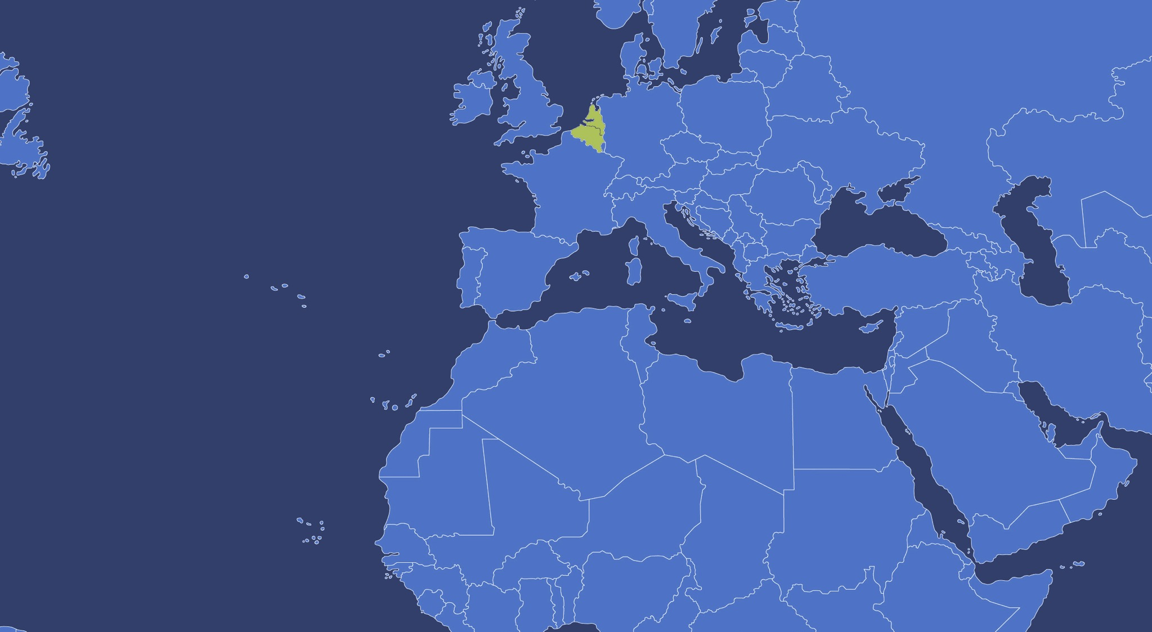



Why The Netherlands,
Waalwijk?
Waalwijk is a municipality and a city in the southern Netherlands – belongs to Province North Brabant.
It had a population of 47,551 in 2017 and is located near the motorways A59 and N261
North Brabant, Transport & Logistic Center of Holland

Slide 21
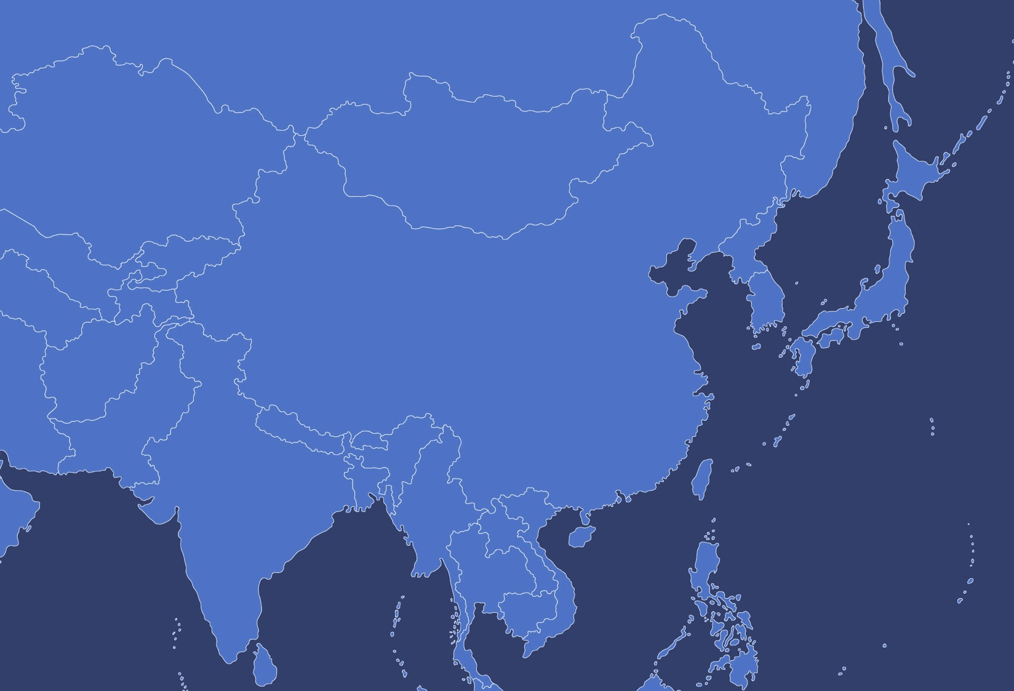



Why The Netherlands,
Waalwijk?
Waalwijk fulfil the great demand for large scale modernized logistic.
Many e-Commerce, multinational companies have built their facilities in this area.
Due to increase of demands, Waalwijk municipal has a plans to build a Barge Terminal for containers coming in through Rotterdam Port.

Slide 22


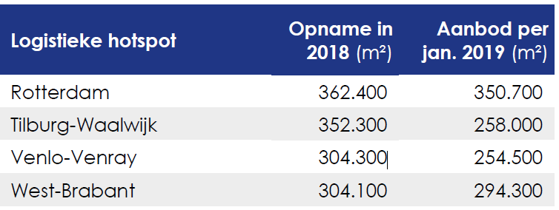
Logistics Hotspots
Rotterdam
Tilburg-Waalwijk
Venlo-Venray
West-Brabant
NOTE
Comparing 2017 & 2018, the increase of demand on modern logistics estate is extremely high at 16%
Investors focus on large scale development and as a results, old existing building are facing many difficulty in renting out due to lack of modern request.
They are forced to upgrade
or rebuild to keep up with
the new demand.
Logistics Hotspots
Due to the extreme space limitation and intolerable rental price in Rotterdam plus Tilburg being fully saturated, which makes Waalwijk naturally the best choice.

Slide 23

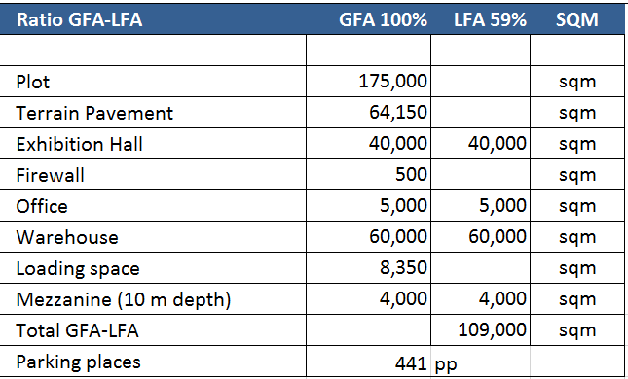
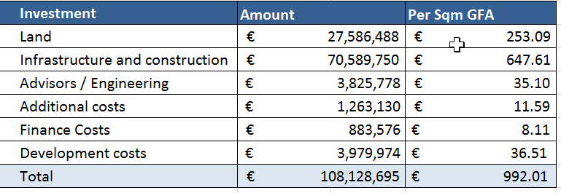
Investment

Slide 24


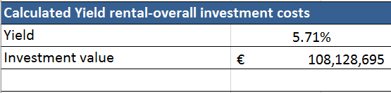
Rental

Slide 25


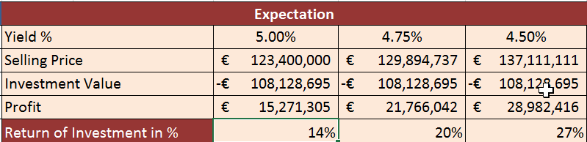
R.O.I.
Return of Investment

Slide 26

DISCLAIMER
© Copyright 2019
All rights reserved; no contents this publication may be reproduced, stored or transmitted in any form or by any means without the consent of the copyright owner.
Project Team / TGI disclaims any and all liability relating to this report, including, without limitation, any express or implied representations or warranties for statements or errors contained in, or omissions from, this report.

Slide 27
TOPGROUP
International B.V.

