Slide 1



COMPANY PROFILE

Slide 2
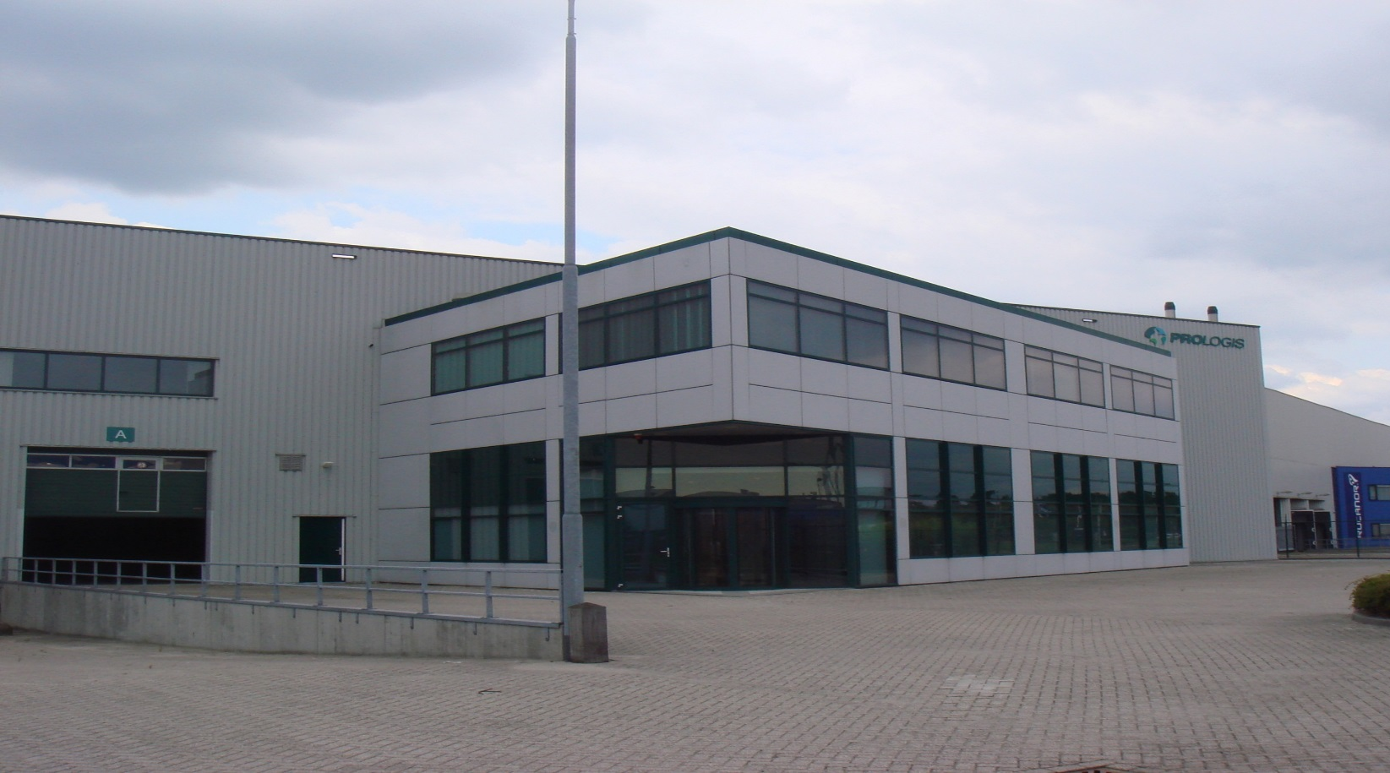
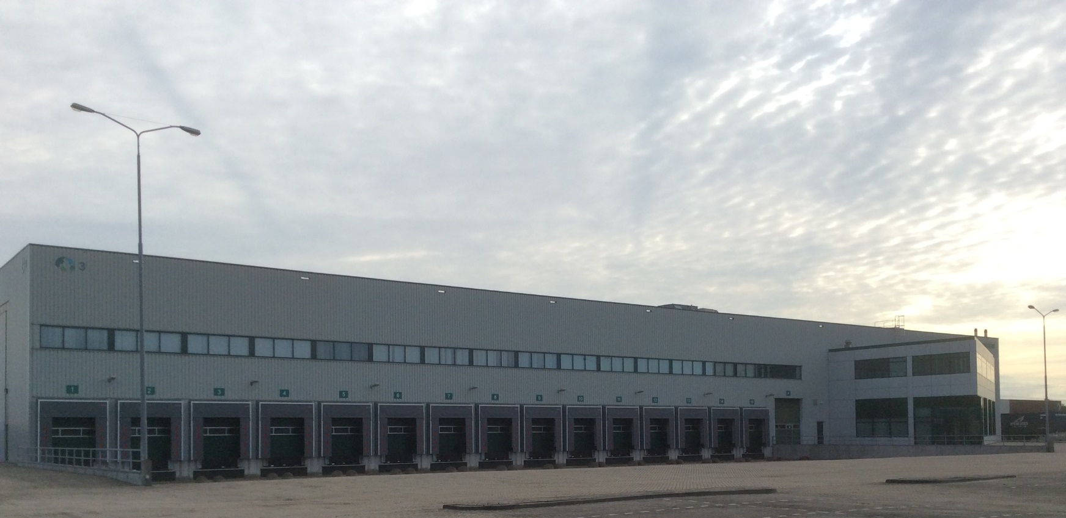
PREMISE IN MOERDIJK

Slide 3
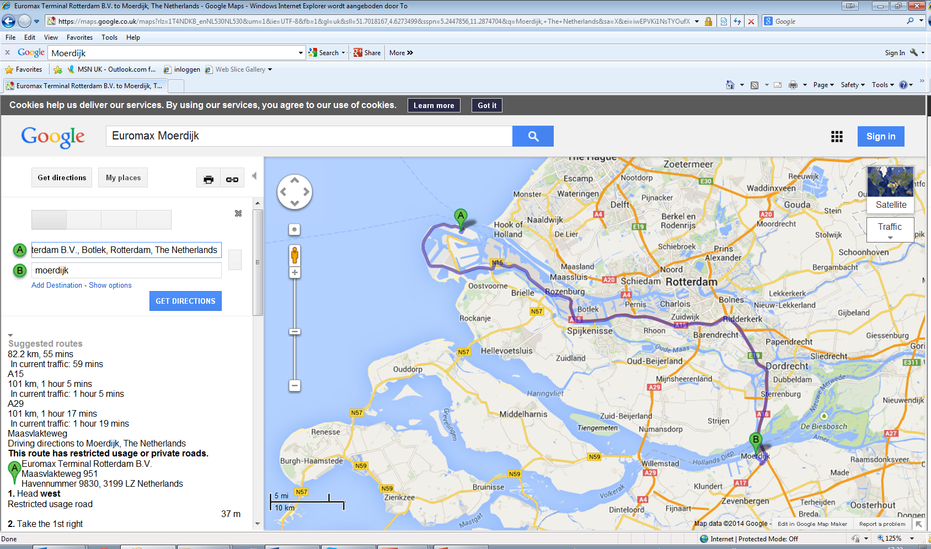

Near Rotterdam Port & Barge Terminal

Slide 4


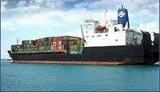

C
O
N
T
E
N
T
S
Top Group International BV
Partner - Suppliers
- Customers
- Choice of Modality
Value added service
Key to success - Quality
- Cost of failure
- B v p
Reporting
TGI services

Slide 5
TOP GROUP INTERNATIONAL BV
Founded 2001
Own Operating Team FTE 35+
Warehouse (Bonded) space 14000 m²
Sea / Air freight, Rail, Barge, Inland transportation
Warehousing, Distribution, Customs services,
Consultancy, Legal, Tax & Finance
Client base (major) 50+: Asus, Foxconn, Delta, Facebook, Phoenix Connect, GP Batteries, Formosa Plastics etc.
High value electronics ( Computer related, TV,
Automotive, Solar Technology, etc.)
Maximum insurance security level in Europe
Rework Project / VAS (Value Added Services)

Slide 6
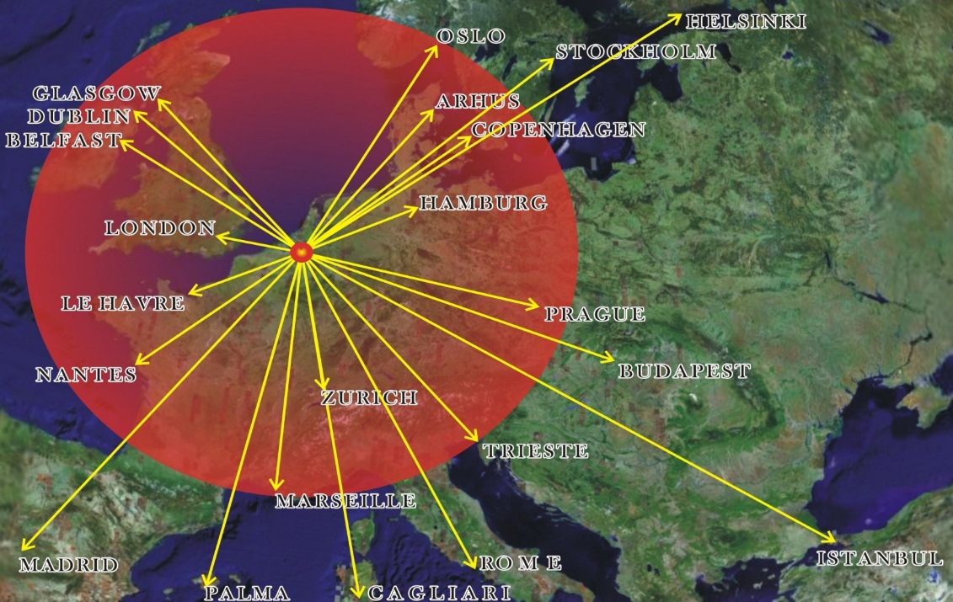
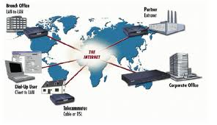

OUR LOCATION
ATTENTION
FROM OUR LOCATION
ANYWHERE IN 96 HOURS
Easy access to the European markets with 1.1 billion consumers.
80% of cargo via Rotterdam port is for German customers while only 50% of cargo via Hamburg is for German customers.
Netherlands is a tax haven for companies which start up business or set up headquarters or a distribution center.
The implementation of tax relief policies avoids double taxation and eases cash flow pressure for companies in the Netherlands and the EU.

Slide 7


































CUSTOMER REFERENCES
Our clients are internationally renowned and leading trading companies and manufacturers.

Slide 8
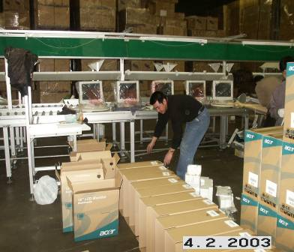

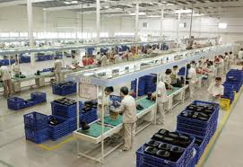
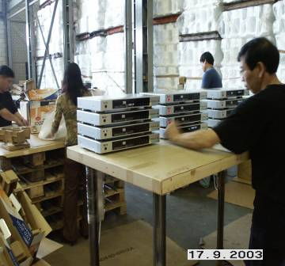
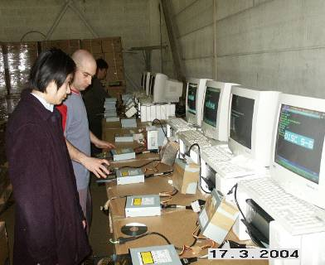
Logistics VALUE ADDED SERVICE
Repacking
Relabeling
Repackaging
Cable, Manuals,
Warranty Cards Etc
Insertion or Swap
Firmware Flashing
Software Updated
Software Upgrade
Technical Work Including Soldering, Jumper
Changing, Rewiring Etc..

Slide 9


Fiscal VALUE ADDED SERVICE
Accounting & Book-Keeping Service
Tax and Financial Declaration Service
Fiscal Representation (LFR / GFR)
Work / Sprouse / Family Permit application
Legal & HR Advise
Tax, Finance and Legal Consultation

Slide 10


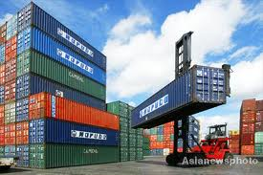



QUALITY
In-house Transportation system Xman
Costs of failure at TGI < 1% (compare: avg 17%*)
Electronic Archive (Paperless)
  Customs registration ( Customs approved)
  ISO9001 certified

Slide 11
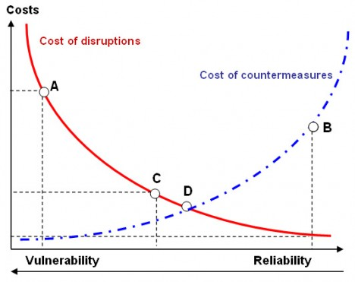

COST OF FAILURE

Slide 12
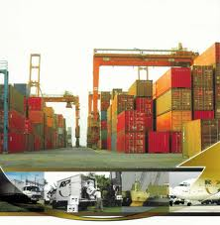
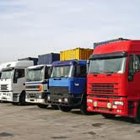
BEST VALUE PROCUREMENT
Permits also considering factors other then price:
Past performance (reliability, flexibility, costs of failure)
Systems and procedures with Tailor made Structural Setup
Quality management + KPI
Tools (IT)
Communication
Reporting
NOTE
Results in Transparency work-flow, Regular Evaluations, Quality performance and Total control.

Slide 13
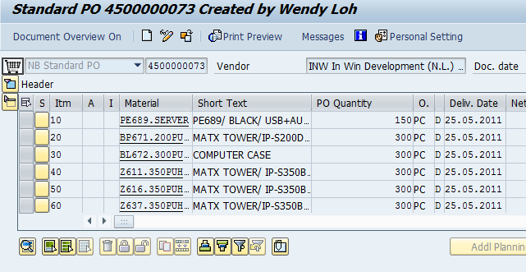
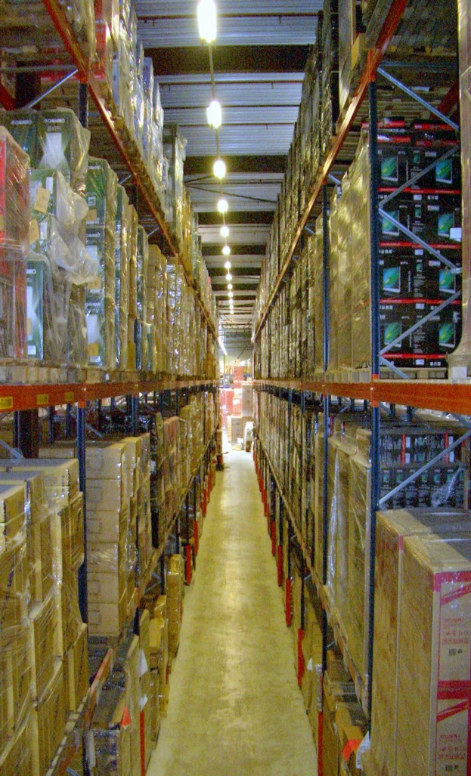
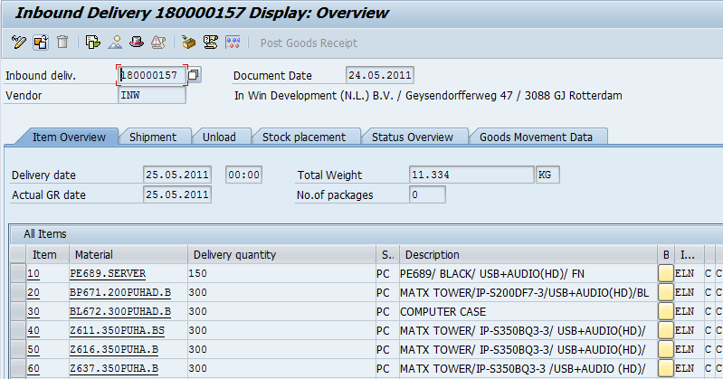
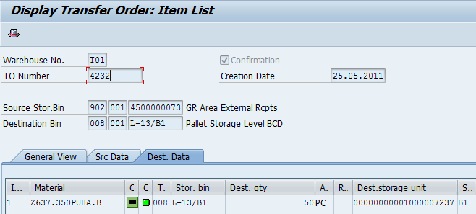
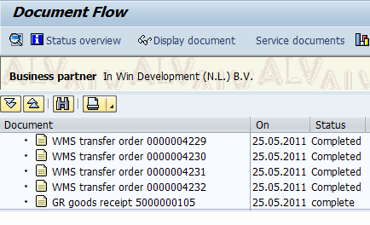
INBOUND PROCESS SCREEN PRINT

Slide 14
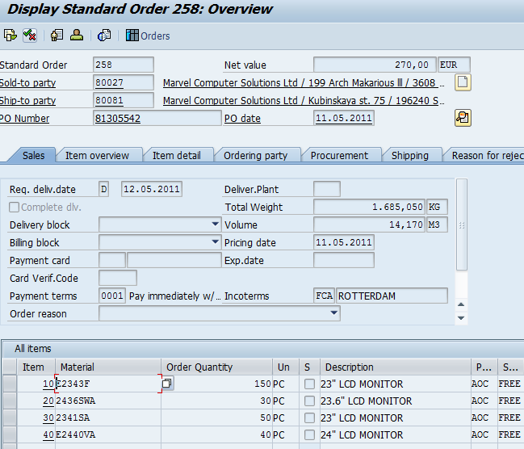
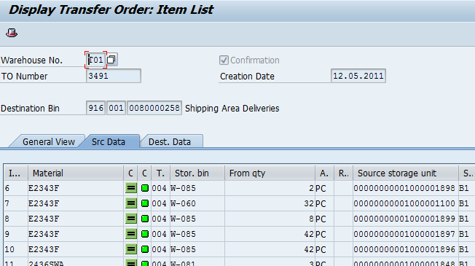
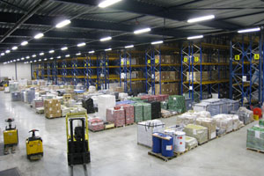
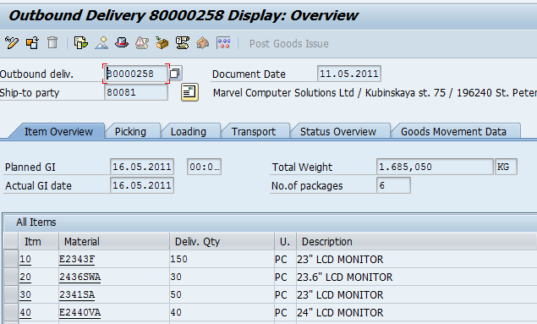
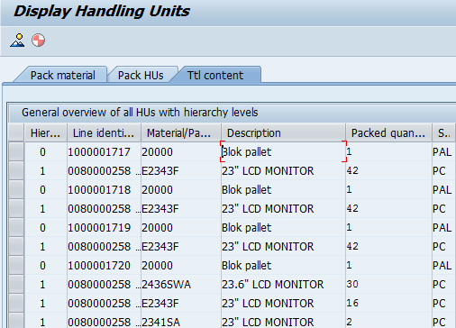
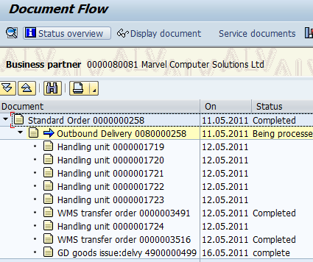
OUTBOUND PROCESS FLOW

Slide 15
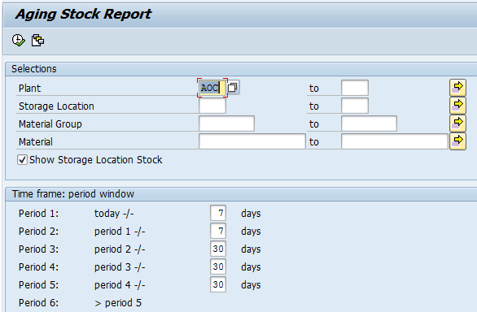
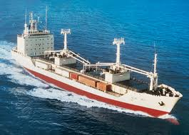
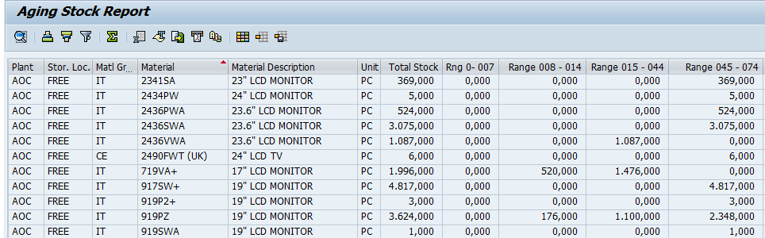
DYNAMIC AGEING REPORT
Freely definable time frame selections
Output can be exported to Excel

Slide 16
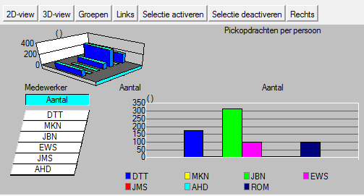
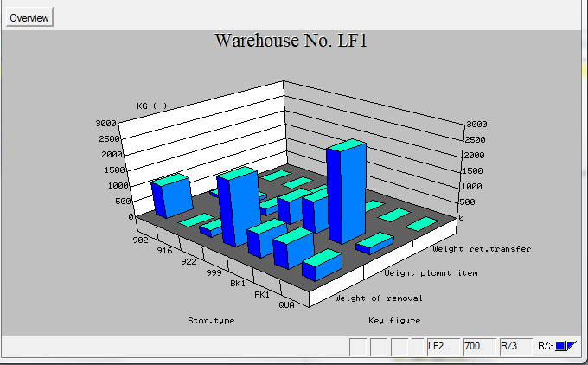
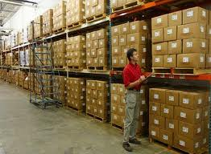
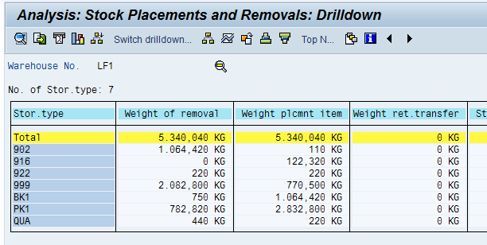
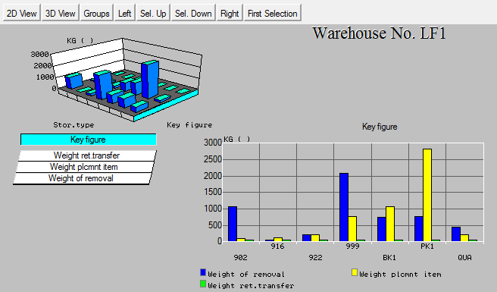
ALL KINDS OF FEATURES REPORT

Slide 17
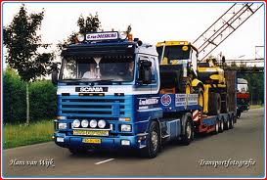

SERVICE OFFER BY TGI
REPORTS | EVALUATIONS | PERFORMANCE
All WMS HANDLING | ELECTRONIC POD UPLOAD | EDI LINK TO TGI SYSTEMS
INVENTORY REPORT INCOMING REPORT OUTGOING REPORT AGEING REPORT PENDING ORDER REPORT | COST BREAKDOWN REPORT BASED ON HANDLING INCOMING GOODS PER SHIPMENT HANDLING OUTGOING GOODS PER SHIPMENT | SALES PERFORMANCE REPORT BY MODEL BY CUSTOMER BY COUNTRY
FULL PRODUCT HISTORY REPORT | LOGISTICS KPI REPORT IN & OUTBOUND | COMPARISON ON FORECAST VS ACTUAL
DYNAMIC AGEING REPORT | LOGISTICS COST ANALYSIS REPORT | WAREHOUSE KPI TRANSPORT KPI
CUSTOMER STOCK STATUS REPORTS PER MODEL PER TRANSPORTATION PER SCHEDULES | COST BREAKDOWN ANALYSES PER BUSINESS UNIT | ACTING AS YOUR PARTNER – RESULT: TRANSPARENT, SYSTEMATIC, STRICT CONTROL OPERATIONAL FLOW

Slide 18
REFERENCES
一帶一路 One Belt One Road - China Project by Rail to Europe. TGI is honored to handle the 1st container by Rail from China to Europe in July 2015
TGI handles dangerous goods from Far East to Hungary.
TGI handles luxury food (chocolate) from Switzerland to Shanghai.
TGI handles agricultural equipment from Europe to China
TGI handles honey from Far East to Netherlands.
TGI is working closely with EMC for empty relocation and cabotage in the Czech Republic and Slovakia.
TGI is the EU Hub for LCY, Delta, Johnson Fitness, Facebook, Foxconn, Phoenix Connect, Formosa Plastics etc.
TGI arranges over Asus’s European distribution from the Netherlands for the last 13 year in a row.
TGI is performing packaging process for GP Batteries, TSP, Delta

Slide 19
THANK YOU

